Slide 1
Computer Organization and Architecture
Lecture14 Pipeline-I
Jihe Wang
wangjihe@nwpu.edu.cn

Slide 2
Today’s Topic
00
01. Recap
02. Introduction of pipeline
03. Hazard
04. Design a pipeline processor
05. Summary

Slide 3
Recall: Performance Evaluation
1
What is the average CPI?
state diagram gives CPI for each instruction type
workload gives frequency of each type
Type CPI_{i} for type Frequency CPI_{i} x freqI_{i}
Arith/Logic 4 40% 1.6
Load 5 30% 1.5
Store 4 10% 0.4
branch 3 20% 0.6
Average CPI: 4.1

Slide 4
Can we get CPI < 4.1?
1.1
Seems to be lots of “idle” hardware
Why not overlap instructions???
PCWr
PCWrCond
PCSrc
Zero
IorD
MemWr
IRWr
RegDst
RegWr
ALUSelA
1
Mux
32
32
PC
32
0
0
Zero
Rs
Mux
0
Ra
32
Mux
RAdr
Rt
5
32
32
Rb
busA
A
1
32
Ideal
Memory
Instruction Reg
5
Reg File
32
ALU
ALU Out
1
Rt
0
4
0
WrAdr
32
Mux
Rw
B
32
32
Rd
1
32
Din
Dout
Mem Data Reg
busW
busB
32
32
1
2
1
Mux
0
3
ALU
Control
<< 2
Imm
Extend
16
32
ALUOp
ExtOp
MemtoReg
ALUSelB

Slide 5
The Big Picture: Where are We Now?
1.2
The Five Classic Components of a Computer
Next Topics:
Pipelining by Analogy
Pipeline hazards
Processor
Input
Control
Memory
Datapath
Output

Slide 6
Today’s Topic
00
01. Recap
02. Introduction of pipeline
03. Hazard
04. Design a pipeline processor
05. Summary

Slide 7
Pipelining is Natural!
2.1
Laundry Example
Ann, Brian, Cathy, Dave each have one load of clothes to wash, dry, and fold
Washer takes 30 minutes
Dryer takes 40 minutes
“Folder” takes 20 minutes
A
B
C
D

Slide 8
Sequential Laundry
2.2
6 PM
7
8
9
10
11
Midnight
Time
30
40
20
30
40
20
30
40
20
30
40
20
T
a
s
k
O
r
d
e
r
A
B
C
D
Sequential laundry takes 6 hours for 4 loads
If they learned pipelining, how long would laundry take?

Slide 9
Pipelined Laundry: Start work ASAP
2.3
6 PM
7
8
9
10
11
Midnight
Time
30
40
40
40
40
20
T
a
s
k
O
r
d
e
r
A
B
C
D
Pipelined laundry takes 3.5 hours for 4 loads

Slide 10
Pipelining Lessons
2.4
Pipelining doesn’t help latency of single task, it helps throughput of entire workload
Pipeline rate limited by slowest pipeline stage
Multiple tasks operating simultaneously using different resources
Potential speedup = Number pipe stages
Unbalanced lengths of pipe stages reduces speedup
Time to “fill” pipeline and time to “drain” it reduces speedup
Stall for Dependences

Slide 11
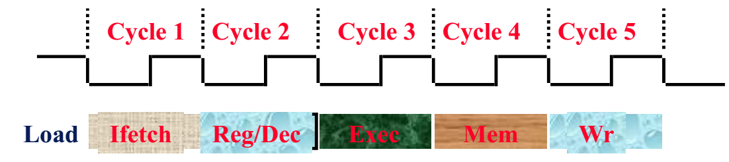
The Five Stages of Load
2.5
Ifetch: Instruction Fetch
Fetch the instruction from the Instruction Memory
Reg/Dec: Register Fetch and Instruction Decode
Exec: Calculate the memory address
Mem: Read the data from the Data Memory
Wr: Write the data back to the register file

Slide 12
Note: These 5 stages were there all along
2.6
Fetch
IR <= MEM[PC]
PC <= PC + 4
0000
Decode
ALUout <= PC +SX
0001
R-type
ORi
LW
BEQ
SW
Execute
ALUout <= A fun B
ALUout <= A op ZX
ALUout <= A + SX
ALUout <= A + SX
If A = B then PC <= ALUout
0100
0110
1000
1011
0010
Memory
M <= MEM[ALUout]
MEM[ALUout] <= B
1001
1100
Write-back
R[rd] <= ALUout
R[rt] <= ALUout
R[rt] <= M
0101
0111
1010

Slide 13
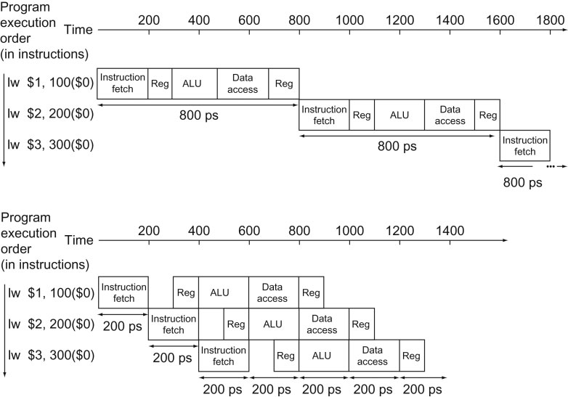
Pipelining
2.7
Improve performance by increasing throughput
Ideal speedup is number of stages in the pipeline. Do we achieve this?

Slide 14
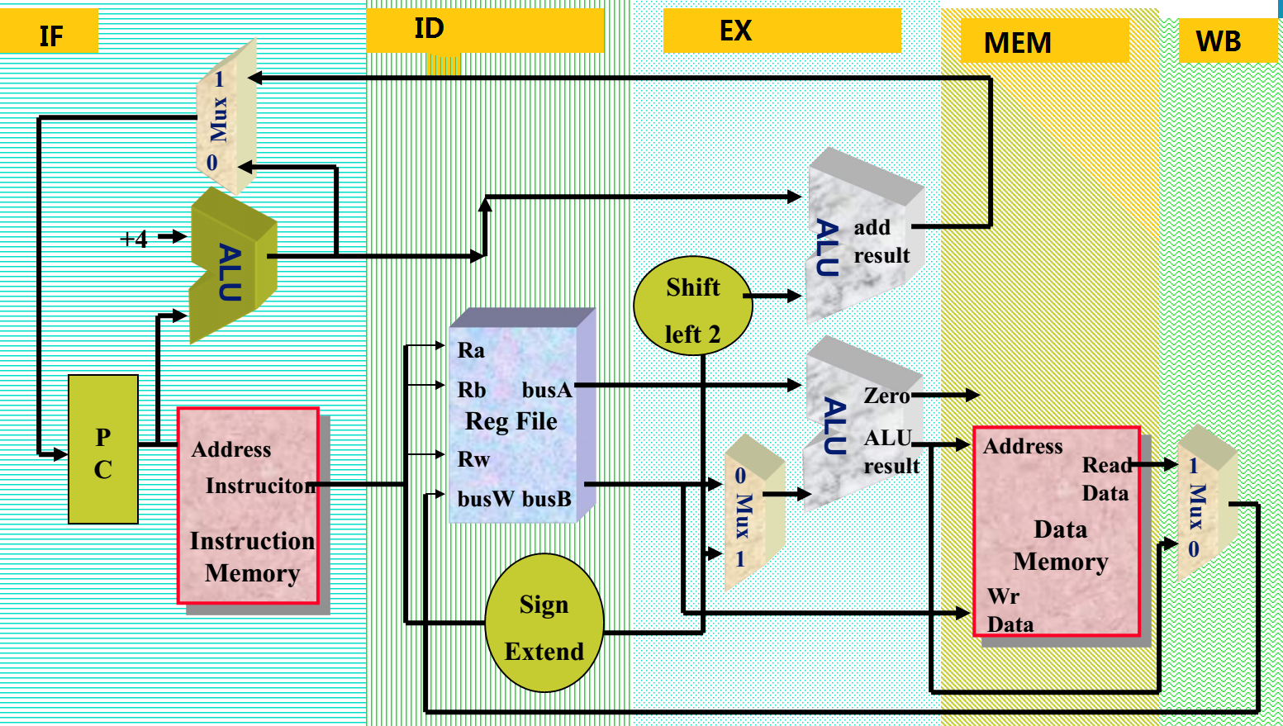
Basic Idea
2.8
What do we need to add to split the datapath into stages?

Slide 15
Graphically Representing Pipelines
2.9
Can help with answering questions like:
how many cycles does it take to execute this code?
what is the ALU doing during cycle 4?
use this representation to help understand datapaths

Slide 16
Conventional Pipelined Execution Representation
2.10
Time
IFetch
Dcd
Exec
Mem
WB
IFetch
Dcd
Exec
Mem
WB
IFetch
Dcd
Exec
Mem
WB
IFetch
Dcd
Exec
Mem
WB
IFetch
Dcd
Exec
Mem
WB
Program Flow
IFetch
Dcd
Exec
Mem
WB
Space-Time Diagram

Slide 17
Single Cycle, Multiple Cycle, vs. Pipeline
2.11
Cycle 1
Cycle 2
Clk
Single Cycle Implementation:
Load
Store
Waste
Cycle 1
Cycle 2
Cycle 3
Cycle 4
Cycle 5
Cycle 6
Cycle 7
Cycle 8
Cycle 9
Cycle 10
Clk
Multiple Cycle Implementation:
Load
Store
R-type
Ifetch
Reg
Exec
Mem
Wr
Ifetch
Reg
Exec
Mem
Ifetch
Pipeline Implementation:
Load
Ifetch
Reg
Exec
Mem
Wr
Store
Ifetch
Reg
Exec
Mem
Wr
R-type
Ifetch
Reg
Exec
Mem
Wr

Slide 18
Why Pipeline?
2.12
Suppose we execute 100 instructions
Single Cycle Machine
45 ns/cycle x 1 CPI x 100 inst = 4500 ns
Multicycle Machine
10 ns/cycle x 4.6 CPI (due to inst mix) x 100 inst = 4600 ns
Ideal pipelined machine
10 ns/cycle x (1 CPI x 100 inst + 4 cycle drain) = 1040 ns

Slide 19
Why pipeline (cont.)?
2.13
Time (clock cycles)
I
n
s
t
r.
O
r
d
e
r
Inst 0
Im
Reg
ALU
Dm
Reg
Inst 1
Im
Reg
ALU
Dm
Reg
Inst 2
Im
Reg
ALU
Dm
Reg
Inst 3
Im
Reg
ALU
Dm
Reg
Inst 4
Im
Reg
ALU
Dm
Reg
To improve the utility of the hardware!

Slide 20
Today’s Topic
00
01. Recap
02. Introduction of pipeline
03. Hazard
04. Design a pipeline processor
05. Summary

Slide 21
Can pipelining get us into trouble?
3.1
Yes: Pipeline Hazards
structural hazards: attempt to use the same resource two different ways at the same time
E.g., combined washer/dryer would be a structural hazard or folder busy doing something else (watching TV)
control hazards: attempt to make a decision before condition is evaluated
E.g., washing football uniforms and need to get proper detergent level; need to see after dryer before next load in
branch instructions
data hazards: attempt to use item before it is ready
E.g., one sock of pair in dryer and one in washer; can’t fold until get sock from washer through dryer
instruction depends on result of prior instruction still in the pipeline

Slide 22
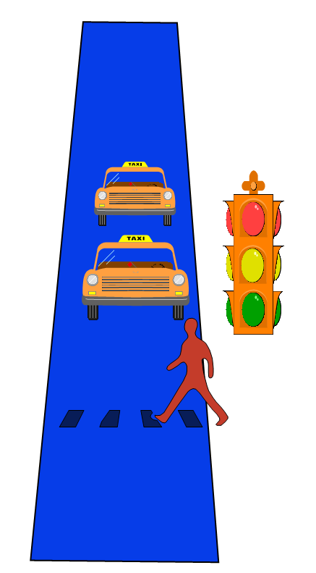
Hazard Solution #1 : Waiting
3.2
Can always resolve hazards by waiting
pipeline control must detect the hazard
take action (or delay action) to resolve hazards

Slide 23
Single Memory is a Structural Hazard
3.3
Time (clock cycles)
I
n
s
t
r.
O
r
d
e
r
Load
Mem
Reg
ALU
Mem
Reg
Instr 1
Mem
Reg
ALU
Mem
Reg
Instr 2
Mem
Reg
ALU
Mem
Reg
Instr 3
Mem
Reg
ALU
Mem
Reg
Instr 4
Mem
Reg
ALU
Mem
Reg
Detection is easy in this case! (right half highlight means read, left half write)

Slide 24
Structural Hazards limit performance
3.4
Example: if 1.3 memory accesses per instruction and only one memory access per cycle then
average CPI ≥ 1.3
otherwise resource is more than 100% utilized

Slide 25
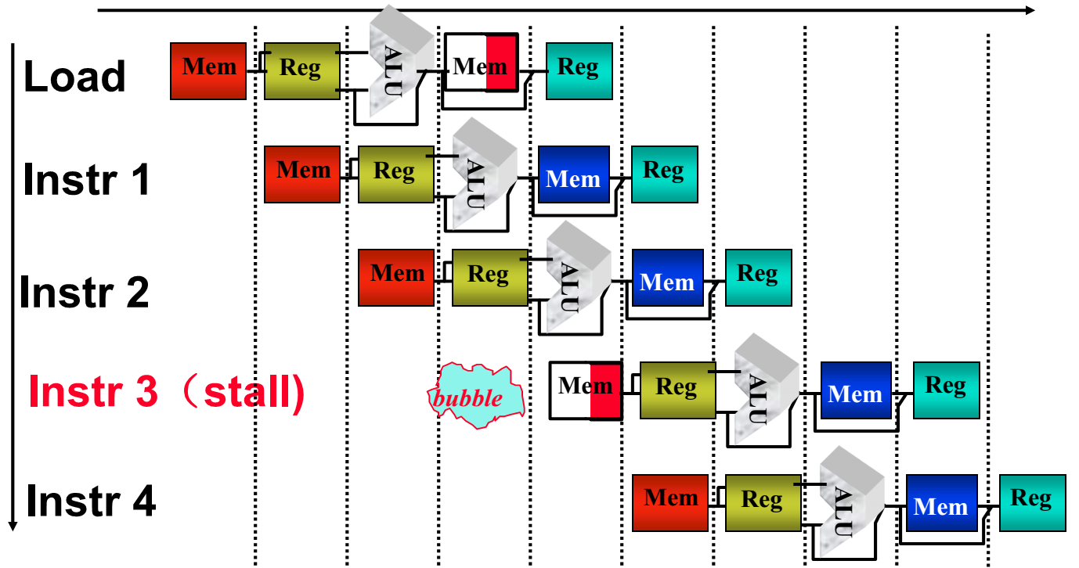
Structural Hazard Solution #1: Stall
3.5

Slide 26
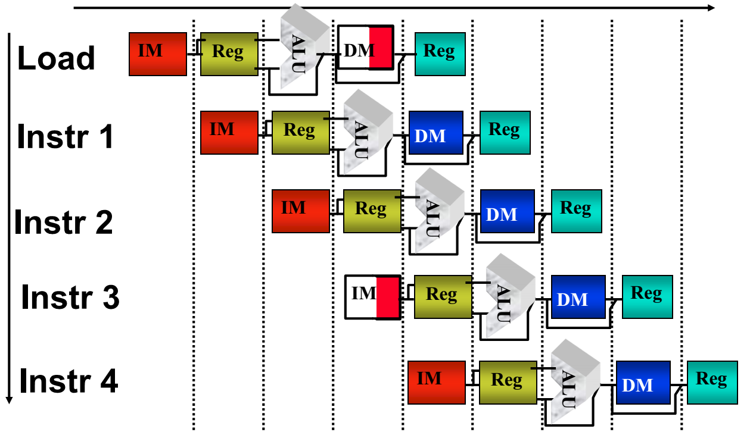
Structural Hazard Solution #2: Resource Copy
3.6
Separated Ins Memory(ICache) and Data Memory(Dcache)

Slide 27
Control Hazard Solution #1: Stall
3.7
I
n
s
t
r.
O
r
d
e
r
Time (clock cycles)
Add
Mem
Reg
ALU
Mem
Reg
Beq
Mem
Reg
ALU
Mem
Reg
Load
Lost
potential
Reg
Mem
Reg
Mem
ALU
Stall: wait until decision is clear
Impact: 2 lost cycles (i.e. 3 clock cycles per branch instruction) => slow
Move decision to end of RegFetch
save 1 cycle per branch

Slide 28
Control Hazard Solution #2: Predict
3.8
I
n
s
t
r.
O
r
d
e
r
Time (clock cycles)
Add
Mem
Reg
ALU
Mem
Reg
Beq
Mem
Reg
ALU
Mem
Reg
Load
Mem
Reg
Mem
Reg
ALU
Predict: guess one direction then back up if wrong
Impact: 0 lost cycles per branch instruction if right, 1 if wrong (right ­ 50% of time)
Need to “Squash” and restart following instruction if wrong
Produce CPI on branch of (1 *.5 + 2 * .5) = 1.5
Total CPI might then be: 1.5 * .2 + 1 * .8 = 1.1 (20% branch)
More dynamic scheme: history of 1 branch (­ 90%)

Slide 29
Control Hazard Solution #3: Delayed Branch
3.9
I
n
s
t
r.
O
r
d
e
r
Time (clock cycles)
Add
Mem
Reg
ALU
Mem
Reg
Beq
Mem
Reg
ALU
Mem
Reg
Misc
Mem
Reg
ALU
Mem
Reg
Load
Mem
Reg
ALU
Mem
Reg
Delayed Branch: Redefine branch behavior (takes place after next instruction)
Impact: 0 clock cycles per branch instruction if can find instruction to put in “slot” (­ 50% of time)
As launch more instruction per clock cycle, less useful

Slide 30
Data Hazard on r1
3.10
add r1,r2,r3
sub r4,r1,r3
and r6,r1,r7
or r8,r1,r9
xor r10,r1,r11

Slide 31
Data Hazard on r1:
3.11
Dependencies backwards in time are hazards
Time (clock cycles)
IF
ID/RF
EX
MEM
WB
add r1,r2,r3
Im
Reg
ALU
Dm
Reg
I
n
s
t
r.
O
r
d
e
r
sub r4,r1,r3
Im
Reg
ALU
Dm
Reg
and r6,r1,r7
Im
Reg
ALU
Dm
Reg
or r8,r1,r9
Im
Reg
ALU
Dm
Reg
xor r10,r1,r11
Im
Reg
ALU
Dm
Reg

Slide 32
Data Hazard Solution:
3.12
“Forward” result from one stage to another
“or” OK if define read/write properly
Time (clock cycles)
IF
ID/RF
EX
MEM
WB
add r1,r2,r3
Im
Reg
ALU
Dm
Reg
I
n
s
t
r.
O
r
d
e
r
sub r4,r1,r3
Im
Reg
ALU
Dm
Reg
and r6,r1,r7
Im
Reg
ALU
Dm
Reg
or r8,r1,r9
Im
Reg
ALU
Dm
Reg
xor r10,r1,r11
Im
Reg
ALU
Dm
Reg

Slide 33
Forwarding (or Bypassing): What about Loads?
3.13
Dependencies backwards in time are hazards
Can’t solve with forwarding:
Must delay/stall instruction dependent on loads
Time (clock cycles)
IF
ID/RF
EX
MEM
WB
lw r1,0(r2)
Im
Reg
ALU
Dm
Reg
sub r4,r1,r3
Im
Reg
ALU
Dm
Reg

Slide 34
Forwarding (or Bypassing): What about Loads
3.14
Dependencies backwards in time are hazards
Can’t solve with forwarding:
Must delay/stall instruction dependent on loads
Time (clock cycles)
IF
ID/RF
EX
MEM
WB
lw r1,0(r2)
Im
Reg
ALU
Dm
Reg
sub r4,r1,r3
Stall
Im
Reg
ALU
Dm
Reg

Slide 35
Running An Example Code I
3.14
sub $2, $1, $3
and $12, $2, $5
or $13, $6, $2
add $14, $2, $2
sw $15, 100($2)

Slide 36
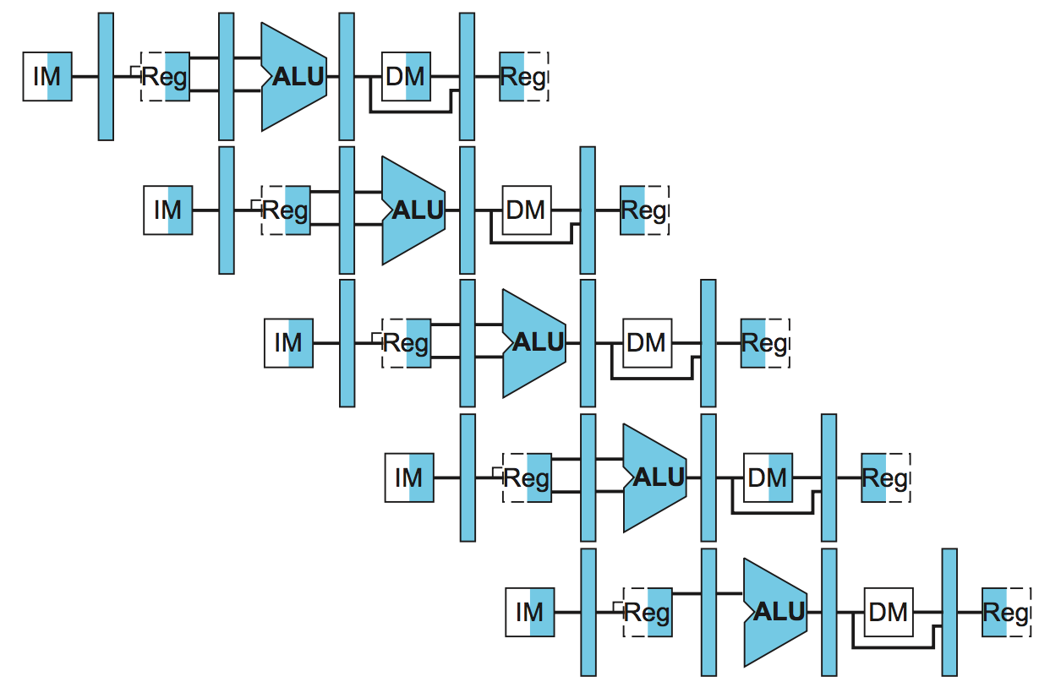
Running An Example Code I
3.14
sub $2, $1, $3
and $12, $2, $5
or $13, $6, $2
add $14, $2, $2
sw $15, 100($2)

Slide 37
Running An Example Code II
2
Initial: $2=10
sub $2, $1, $3
and $12, $2, $5
or $13, $6, $2
add $14, $2, $2
sw $15, 100($2)
After: $2=-20

Slide 38
Running An Example Code II
2
Initial: $2=10
$2=10
sub $2, $1, $3
and $12, $2, $5
or $13, $6, $2
add $14, $2, $2
sw $15, 100($2)
After: $2=-20

Slide 39
Running An Example Code II
2
Initial: $2=10
$2=10
sub $2, $1, $3
and $12, $2, $5
or $13, $6, $2
add $14, $2, $2
sw $15, 100($2)
After: $2=-20
$2=10

Slide 40
Running An Example Code II
2
Initial: $2=10
$2=-20
sub $2, $1, $3
and $12, $2, $5
or $13, $6, $2
add $14, $2, $2
sw $15, 100($2)
After: $2=-20

Slide 41
Running An Example Code II
2
Initial: $2=10
$2=-20
sub $2, $1, $3
and $12, $2, $5
or $13, $6, $2
add $14, $2, $2
sw $15, 100($2)
After: $2=-20
Notes:
Data Hazard: RAW (Read after Write)

Slide 42
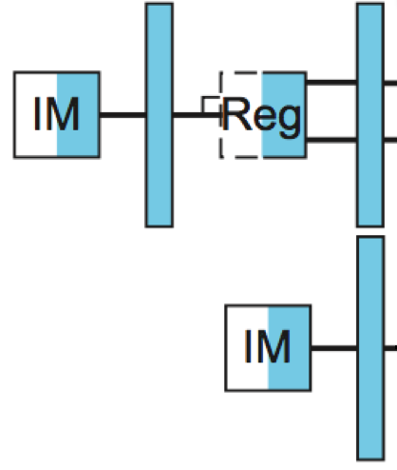
Running An Example Code II
2
Initial: $2=10
$2=-20
sub $2, $1, $3
and $12, $2, $5
or $13, $6, $2
add $14, $2, $2
sw $15, 100($2)
After: $2=-20
Nop
Nop
$2=-20
$2=-20
$2=-20
Notes:
Nop.

Slide 43
Solution of Data Hazard: Forwarding
3
When is the new results of the ”sub” produced?
Initial: $2=10
sub $2, $1, $3
and $12, $2, $5
or $13, $6, $2
add $14, $2, $2
sw $15, 100($2)
After: $2=-20

Slide 44
Solution of Data Hazard: Forwarding
3
When is a new $2 value produced?
Initial: $2=10
-20
sub $2, $1, $3
and $12, $2, $5
or $13, $6, $2
add $14, $2, $2
sw $15, 100($2)
After: $2=-20

Slide 45
Solution of Data Hazard: Forwarding
3
When is a new $2 value produced?
-20
Initial: $2=10
sub $2, $1, $3
and $12, $2, $5
or $13, $6, $2
add $14, $2, $2
sw $15, 100($2)
After: $2=-20
Notes:
Forwarding(前推)

Slide 46
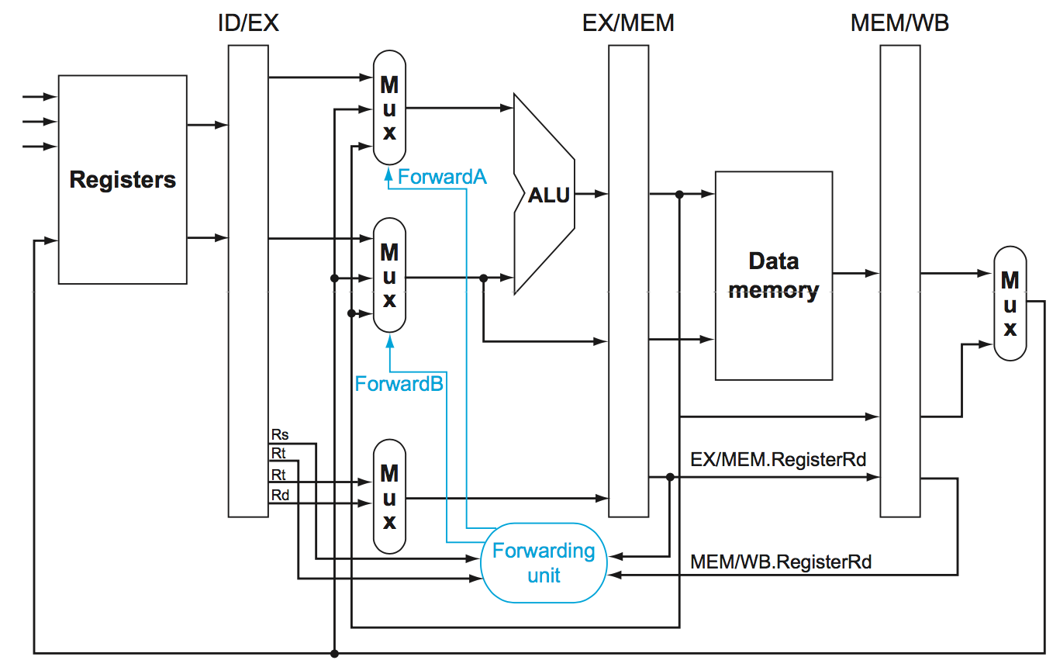
Data Hazard Conditions
4
Notes:
4 Condistions

Slide 47
Data Hazard Conditions
4
1a. ID/EX.Rs=EX/MEM.Rd
1b. ID/EX.Rt=EX/MEM.Rd
2a. ID/EX.Rs=MEM/WB.Rd
2b. ID/EX.Rt=MEM/WB.Rd

Slide 48
Today’s Topic
00
01. Recap
02. Introduction of pipeline
03. Hazard
04. Design a pipeline processor
05. Summary

Slide 49
Designing a Pipelined Processor
4.
Go back and examine your datapath and control diagram
associated resources with states
ensure that flows do not conflict, or figure out how to resolve
assert control in appropriate stage

Slide 50
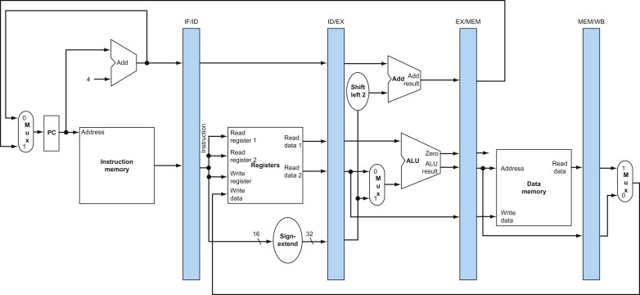
Pipeline Registers
4.1

Slide 51
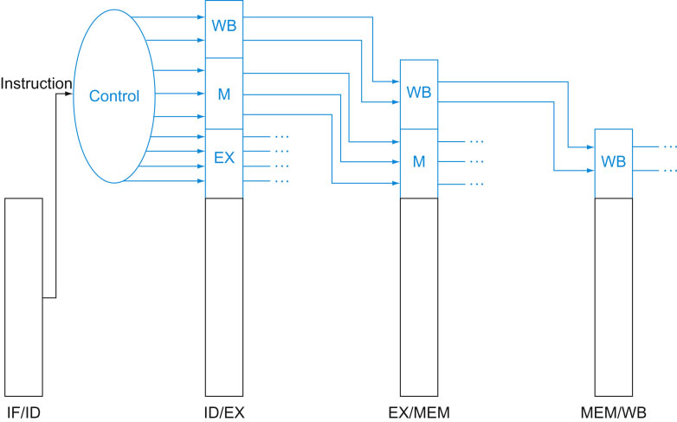
The control lines for the final three stages
4.2

Slide 52
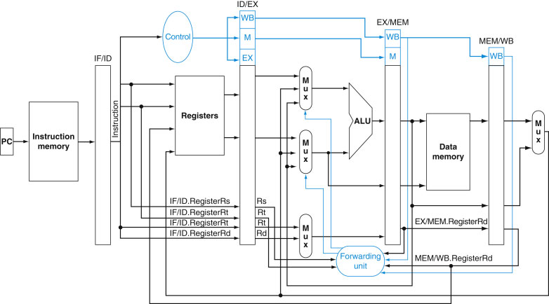
Datapath with forwarding
4.3

Slide 53
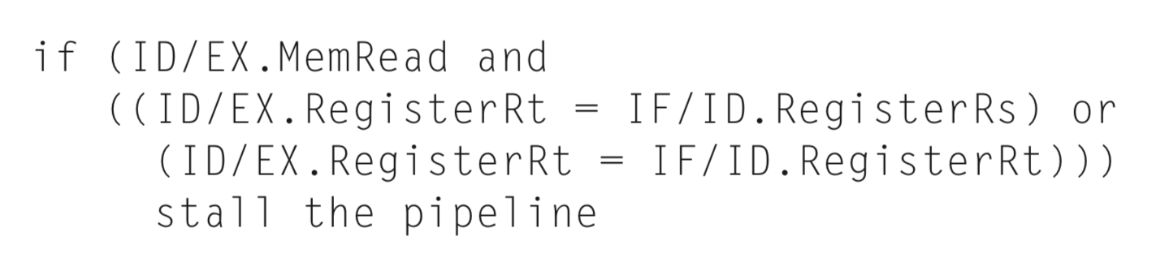
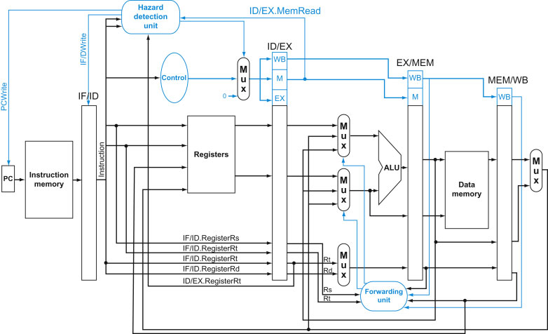
Hazard detection unit & forwarding unit
4.4
Why here?
Notes:
Why here?
No instruction can be issued buy PC
If at ALU stage or later, next instructions have been issued and cannot pause, too late.

Slide 54
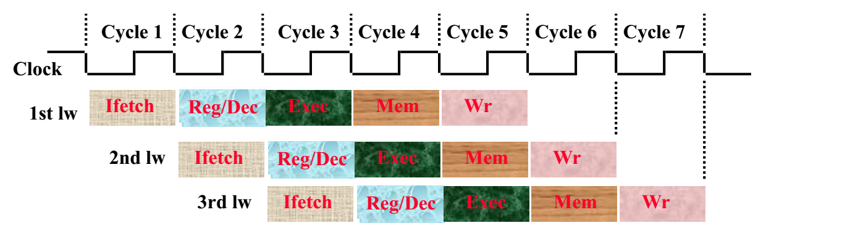
Pipelined load instructions
4.5

Slide 55
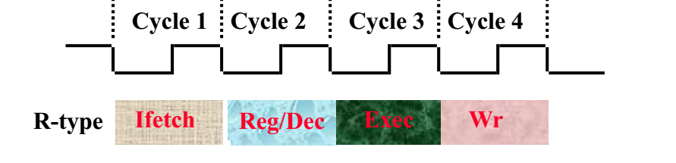
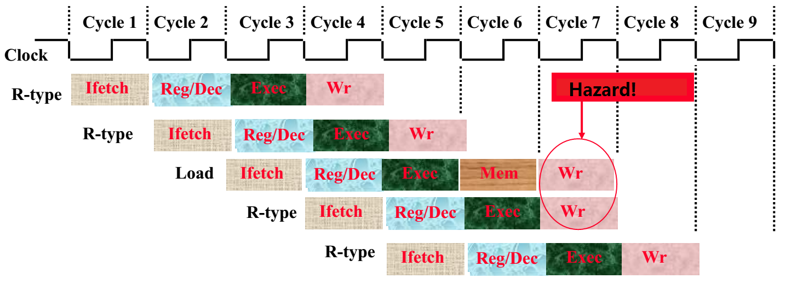
Pipelined load and R-type instructions
4.6

Slide 56
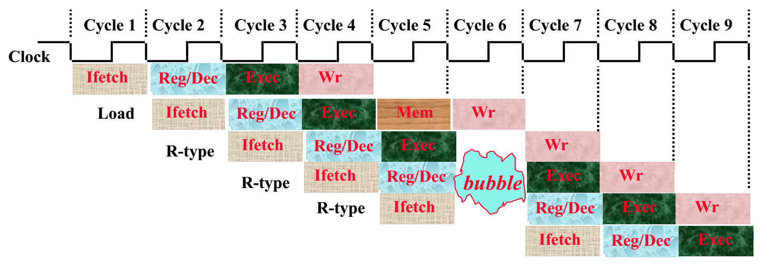
Solution #1: Insert bubble
4.7
More complex in control
No instruction is started in cycle 6!

Slide 57
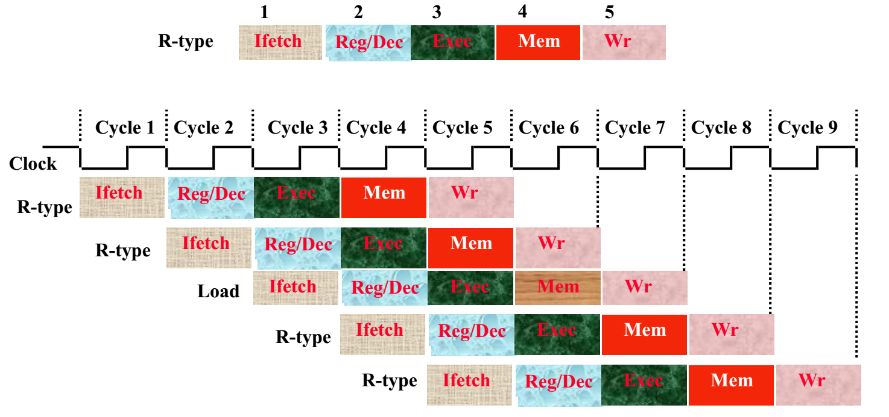
Solution #2: Delay WB in R-type
4.8
Do nothing during the Mem stage of R-type!

Slide 58
Summary: Pipelining
5
Reduce CPI by overlapping many instructions
Average throughput of approximately 1 CPI with fast clock
Utilize capabilities of the Datapath
start next instruction while working on the current one
limited by length of longest stage (plus fill/flush)
detect and resolve hazards
What makes it easy
all instructions are the same length
just a few instruction formats
memory operands appear only in loads and stores
What makes it hard?
structural hazards: suppose we had only one memory
control hazards: need to worry about branch instructions
data hazards: an instruction depends on a previous instruction

